Slide 1
TWITTER OR X SENTIMENT ANALYSIS USING SUPERVISED LEARNING MODELS
SUBMITTED BY:
ANUPAM ANIL
DATA ANALYTICS
TECHOLAS TCHNOLOGIES
KOCHI
SUBMITTED TO:
SHAYANA
FACULTY , DATA ANALYTICS
TECHOLAS TECHNOLOGIES
KOCHI

Slide 2
Objective
This project explores in detail the process of sentiment analysis from tagging and labelling data and classifying sentiments manually to creating a ML Model to automate this prediction.
Depression and Anxiety are alarmingly becoming common in today’s modern stressful world. It leads to adverse effects and consequences both for the person themselves and all their loved ones.
Early prediction especially using text messages on social media platform will help people seek help and prevent adverse consequence.

Slide 3
Design of Website
Front End : HTML and CSS
Framework : Flask
Back End : Python and Flask
Environment used : Jupyter Notebook, Visual Studio Code

Slide 4
Process on Dataset
DATA COLLECTION
DATA PRE-PROCESSING
DATA STANDARDIZATION AND SPLIT TO TRAIN AND TEST
MODEL SELECTION
FITTING THE TRAINED DATA IN MODEL
MODEL TRAINING AND TESTING
PREDICTING THE TEST DATA
PREDICTED CLASS LABELS

Slide 5
Dataset
Input: Message to examine, Label (depression result).
Output: Predict if Depressed or Not Depressed.

Slide 6
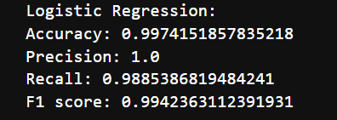
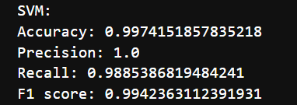
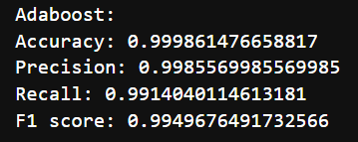
Result Obtained
Results obtained in each models:
1. Logistic Regression
2. SVM
3. Adaboost Classifier

Slide 7
Comparison Table
Models | Accuracy (%) | Precision (%) | Recall (%) | F1 Score (%)
Logistic Regression | 99.74 | 100 | 98.85 | 99.42
SVM | 99.74 | 100 | 98.85 | 99.42
Adaboost Classifier | 99.99 | 99.85 | 99.14 | 99.50
Note: Adaboost Classifier is the most Accurate model.

Slide 8
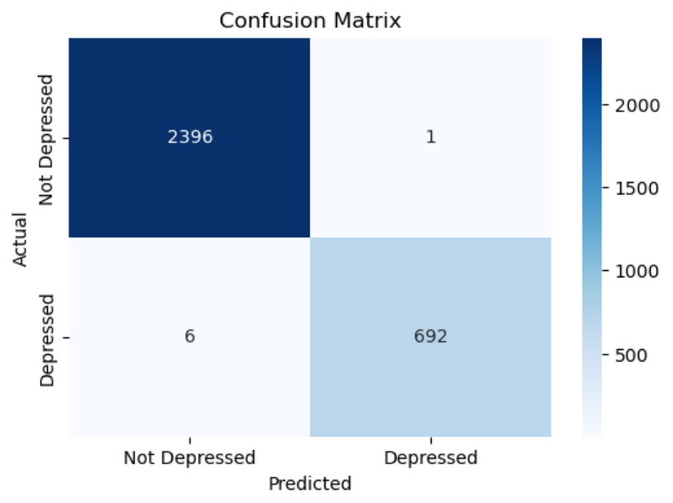
Confusion Matrix : Heat Map
True Positive (TP): Correctly predicted as depressed - 692
True Negative (TN): Correctly predicted as not depressed - 2396
False Positive (FP): Incorrectly predicted as depressed - 1
False Negative (FN): Incorrectly predicted as not depressed - 6

Slide 9
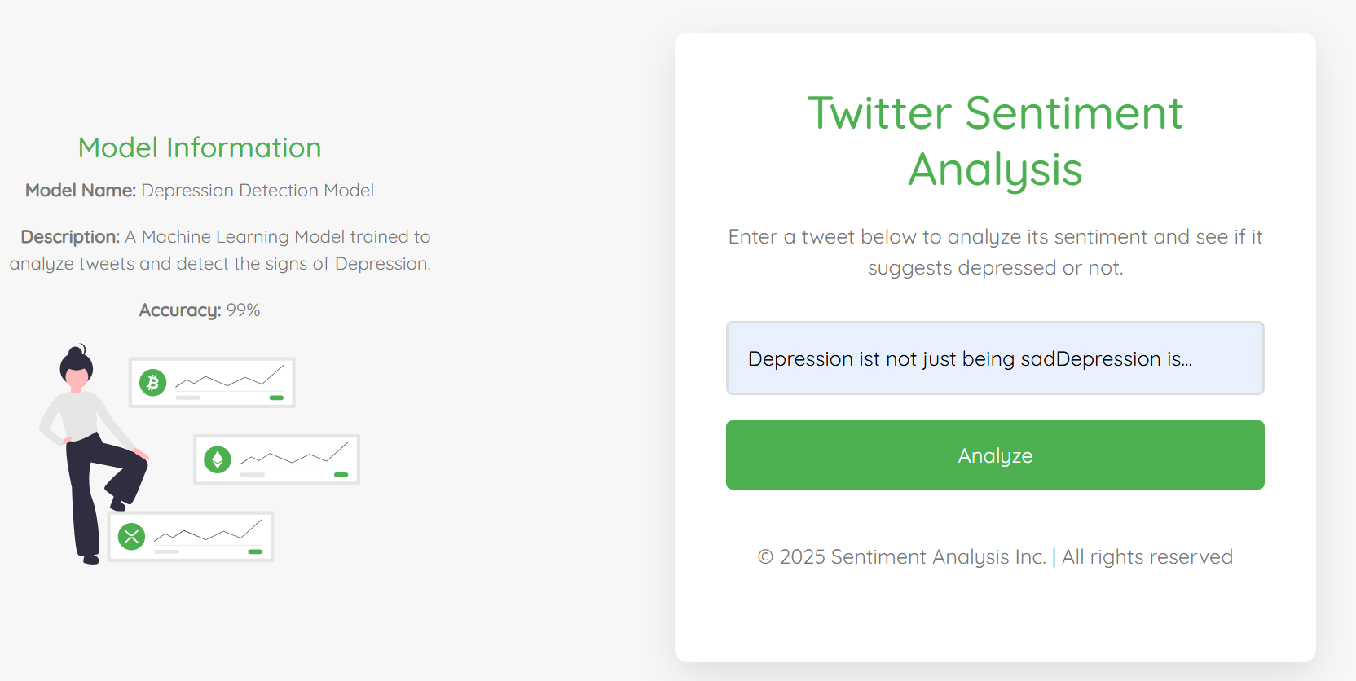
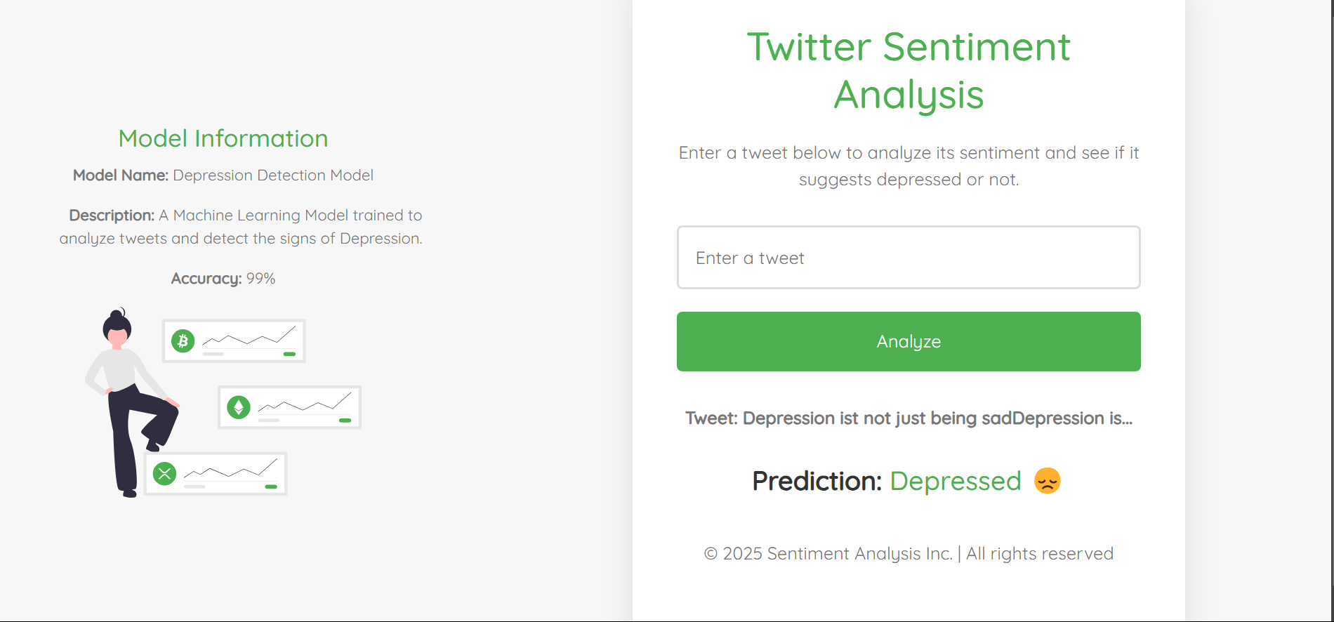
User Interface
Screenshot of User Interface

Slide 10

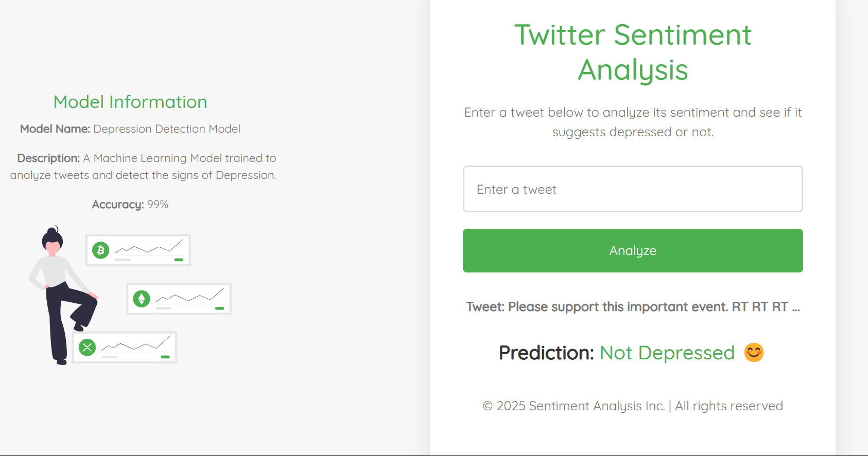
User Interface
Screenshot of User Interface

Slide 11
Application
Early Detection of Depression: Monitor tweets for negative sentiment patterns, signalling potential depression for early intervention.
Mental Health Trend Monitoring: Track regional or demographic shifts in emotional sentiment to identify emerging mental health issues
Crisis Monitoring: Detect urgent emotional distress, such as suicidal thoughts, for immediate intervention.
Targeted Outreach: Focus mental health outreach on groups showing high levels of negative sentiment.

